Slide 1
Protect your office 365 email from Three key threats
June, 2016
Notes:
Protect Your Office 365 Email from Three Key Threats
As you look to migrate your email infrastructure to Office 365, you might be wondering what the right approach and technology is to stop exploding threats such as business email compromise and ransomware. Hear about key requirements for catching email spoofs, emerging and zero day threats, and even commodity threats. Considerations for threat visibility and response requirements will also be explored.
https://www.proofpoint.com/us/threat-insight/post/quarterly-threat-summary-dridex-ransomware-bec-phishing-hog-spotlight
https://threatpost.com/fbi-email-scams-take-3-1-billion-toll-on-businesses/118696/?platform=hootsuite
https://www.proofpoint.com/us/threat-insight/post/quarterly-threat-summary-dridex-ransomware-bec-phishing-hog-spotlight
bio
poll
links to resources
seed questions

Slide 2
Agenda
Threat landscape
Threat samples
Key requirements
How Proofpoint helps
Learn more
Notes:
As you look to migrate your email infrastructure to Office 365, you might be wondering what the right approach and technology is to stop exploding threats such as business email compromise and ransomware. Hear about key requirements for catching email spoofs, emerging and zero day threats, and even commodity threats. Considerations for threat visibility and response requirements will also be explored.
6/23 or 6/28 could work.

Slide 3
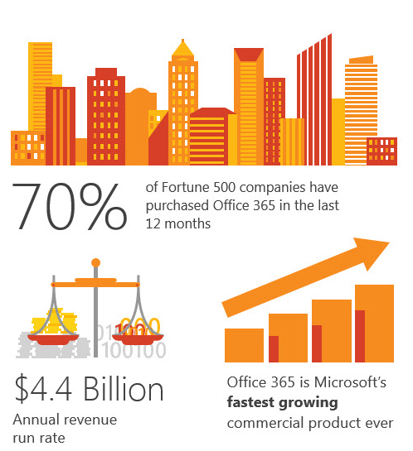
The Move to Office 365
The collaboration benefits of Office 365 are driving rapid adoption.
But many organizations have unanswered questions, some of which are:
How can I protect my Office 365 instance from advanced threats and targeted attacks?
Will I have the threat insights needed to identify these attacks?
Once identified, how will I orchestrate rapid response and containment?
What can I do to ensure service availability for O365-based email?
Notes:
Exchange Online is driving move to Office 365, good opportunity to reassess email security requirements
If you’re like many, you’re looking to support the migration to Office 365, assessing how to deliver effective security while delivering cost savings to the business.
Many organizations have unanswered questions when they evaluate Office 365 email security.
We’ve helped many organizations make the transition to Office 365 smoothly, while still maintaining a TCO benefit when comparing the cost of [on-premises email infrastructure + existing email security] vs. [Office 365 email infrastructure + Proofpoint email security].

Slide 4
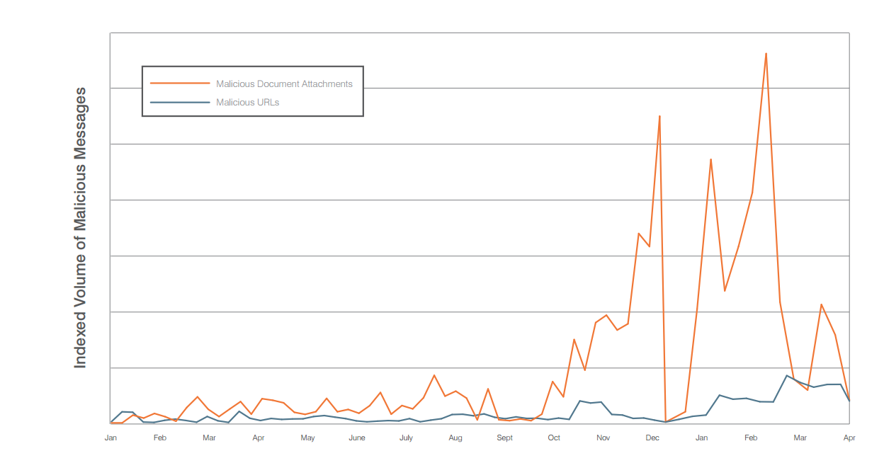
Source: Proofpoint Threat Insights
Notes:
Interesting change from 2014, where URL threats dominated.
What the world looks like today. Shows the ridiculousness of the threat landscape right now. If you think back to July, we thought it was a big deal when we saw a 700k email Dridex campaign, which barely registers as a little blip in this chart in context to what we’re seeing now. This is why we see organizations getting slammed with documents with malicious attachments, and even URLs, are back on the uptick. This is an order of magnitude bigger problem what it used to be on a global scale. If you consider the campaign yesterday (5/23), it was big enough to send an email to every person on the planet. If you extrapolate what we saw (40M emails), across the world’s organizations. This is absolutely unprecedented in terms of scale, and why people are having a really hard time.

Slide 5
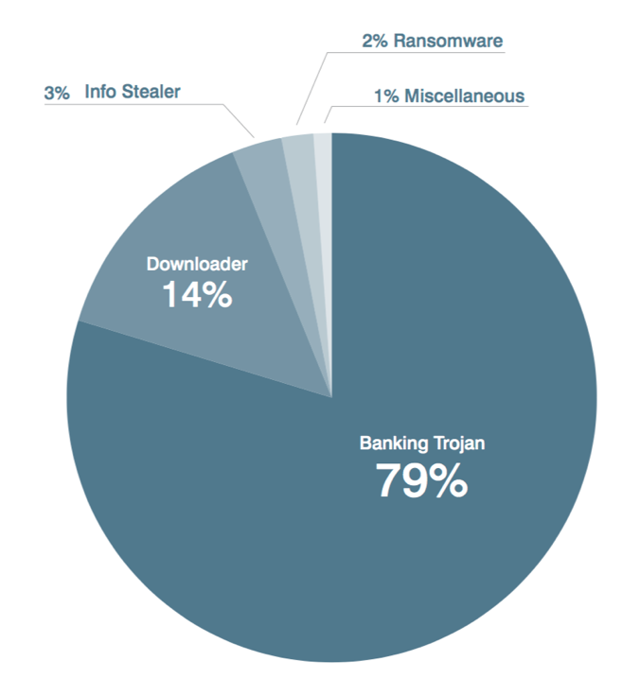
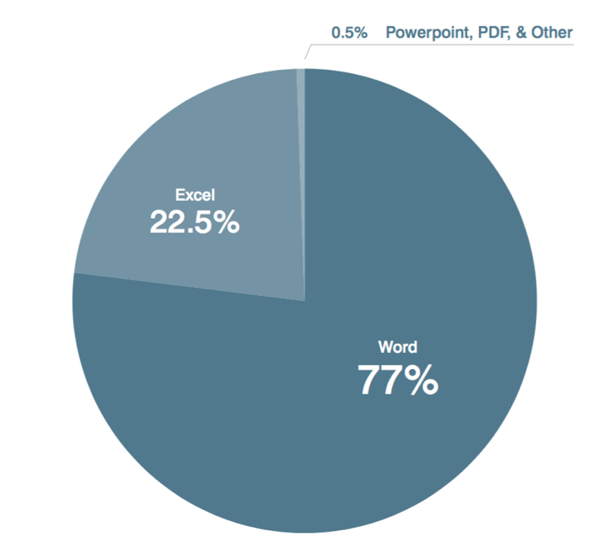
Malware payloads most frequently delivered by malicious document attachments in 2015
Top document attachments formats, 2015
Source: The Human Factor 2016
Notes:
When it comes to protecting a user in 2016, a lot of these attacks don’t use any mlalware at all
i.e. credential, bec, thin lures, are absolutely endeminc, even in sophisticated attack
Game is no longer than just ufing a sandbox,
Have to use people, bare mental, creative approaches
This is what the threat landscape looked like in 2015,
# in 2016, this looks significantly different. Ransomware is north of 30%, where it was only 2%
Actual document makeup, word/excel continue to dominate.

Slide 6
Notes:
Interesting change from 2014, where URL threats dominated.
What the world looks like today. Shows the ridiculousness of the threat landscape right now. If you think back to July, we thought it was a big deal when we saw a 700k email Dridex campaign, which barely registers as a little blip in this chart in context to what we’re seeing now. This is why we see organizations getting slammed with documents with malicious attachments, and even URLs, are back on the uptick. This is an order of magnitude bigger problem what it used to be on a global scale. If you consider the campaign yesterday (5/23), it was big enough to send an email to every person on the planet. If you extrapolate what we saw (40M emails), across the world’s organizations. This is absolutely unprecedented in terms of scale, and why people are having a really hard time.

Slide 7
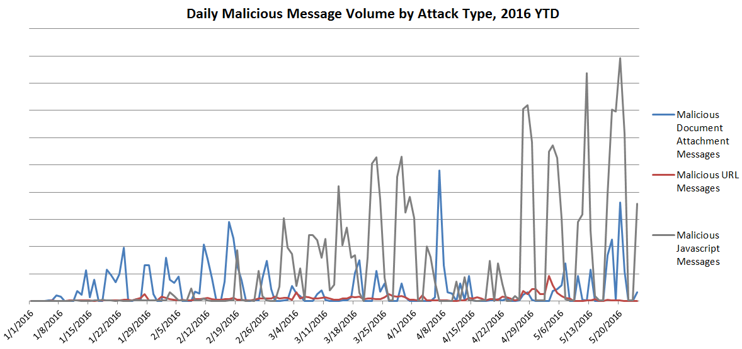
2016 Explosion of Javascript Attachments (beyond Office/PDF)
Notes:
Threats change, defense needs to be nimble
Javascript has entered the picture.
New trend in malicious email campaigns: attached Javascript files
Sheer volume 4-8x other document types
Evasion strategies
Not all solutions scan this file type
Users have not been widely trained about js files
Beware of Javascript
https://www.proofpoint.com/us/threat-insight/post/beware-javascript-malicious-email-campaigns-with-js-attachments-explode
New tend in malicious email campaigns – attached JavaScript files.
While threat actors have been using attached Microsoft Office files with embedded malicious macros for years and both users and most antivirus applications are generally aware of the dangers of .exe files (executables) attached to emails, the use of .js directly in email has only been used occasionally in the past. Moreover, these campaigns are appearing in unprecedented volumes with hundreds of millions of messages being sent across our customer base.
So why .js? According Bryan Burns, Vice President of Threat Research at Proofpoint,
“Users have been trained to not click exe attachments, but many may not know what a “js” file is, or that it can be just as dangerous. The icon looks like a document which is somewhat confusing to users unfamiliar with this file type.”
These are, in fact, the largest campaigns observed in recent years by Proofpoint researchers, relying on massive botnets to distribute huge volumes of malicious emails.
While many of the emails in these campaigns have the .js files attached without modification, others use obfuscated JavaScript, come with different file extensions, or appear in compressed files to further obscure the malicious nature of the attached files for recipients.
The sheer message volume is also a distinguishing feature of these campaigns. The graph below shows the relative volumes of .js attachments versus other malicious documents in recent campaigns, with .js messages exceeding all other document attachments combined by 4-8 times at their peaks:
These campaigns are of concern because
Their massive volumes dramatically increase the risk of finding recipients without sufficient electronic protections or who don't recognize potentially malicious file attachments and
The files are not immediately recognizable as malicious (like .exe files) and don't generate macro-related warning messages.
For both organizations and individuals, this means that using antimalware solutions capable of detecting advanced threats becomes more important than ever. At the same time, we need to ensure that users remain vigilant in email best practices and are aware of the growing variety of attached documents that may be malicious.

Slide 8
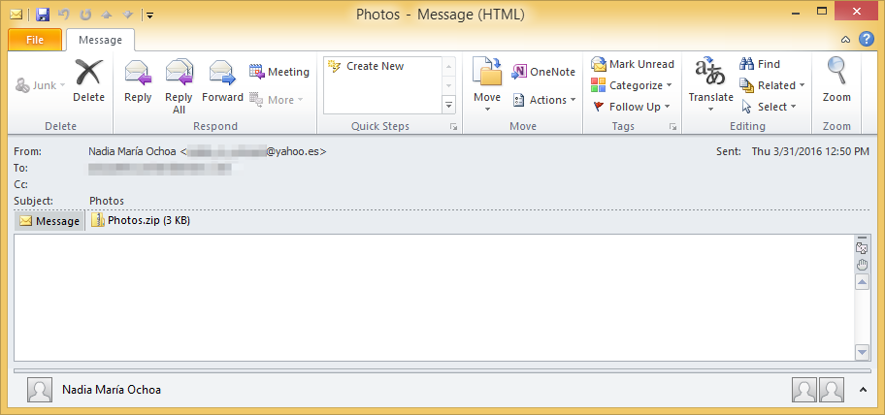
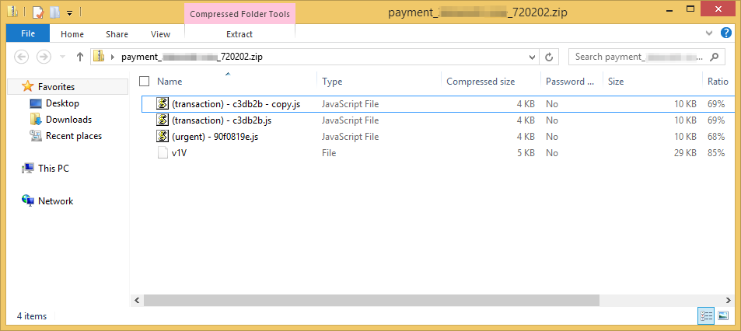
Locky Cybercriminals Continue Innovation
Embedding threats in archive files
“RockLoader” = attachments + malware variant
Intermediary installing Locky and potentially other malware, including Dridex 220, Pony, and Kegotip
Delivery strategies vary to evade security:
  Convoluted JavaScript obfuscation
  Additional junk files to help evade detections
  Mangled “Content-Type” headers
  The use of RAR instead of Zip of JavaScript
Threat actors are working quickly to evade detection
Email delivering the zipped JavaScript and
attachment containing malicious .js files and a junk v1V file
Notes:
Wednesday, April 6, 2016
Rapid evolution of delivery mechanisms and obfuscation techniques show that threat actors are working quickly to evade detection
For more information: http://proofpoint.com/us/threat-insight/post/Locky-Ransomware-Cybercriminals-Introduce-New-RockLoader-Malware

Slide 9
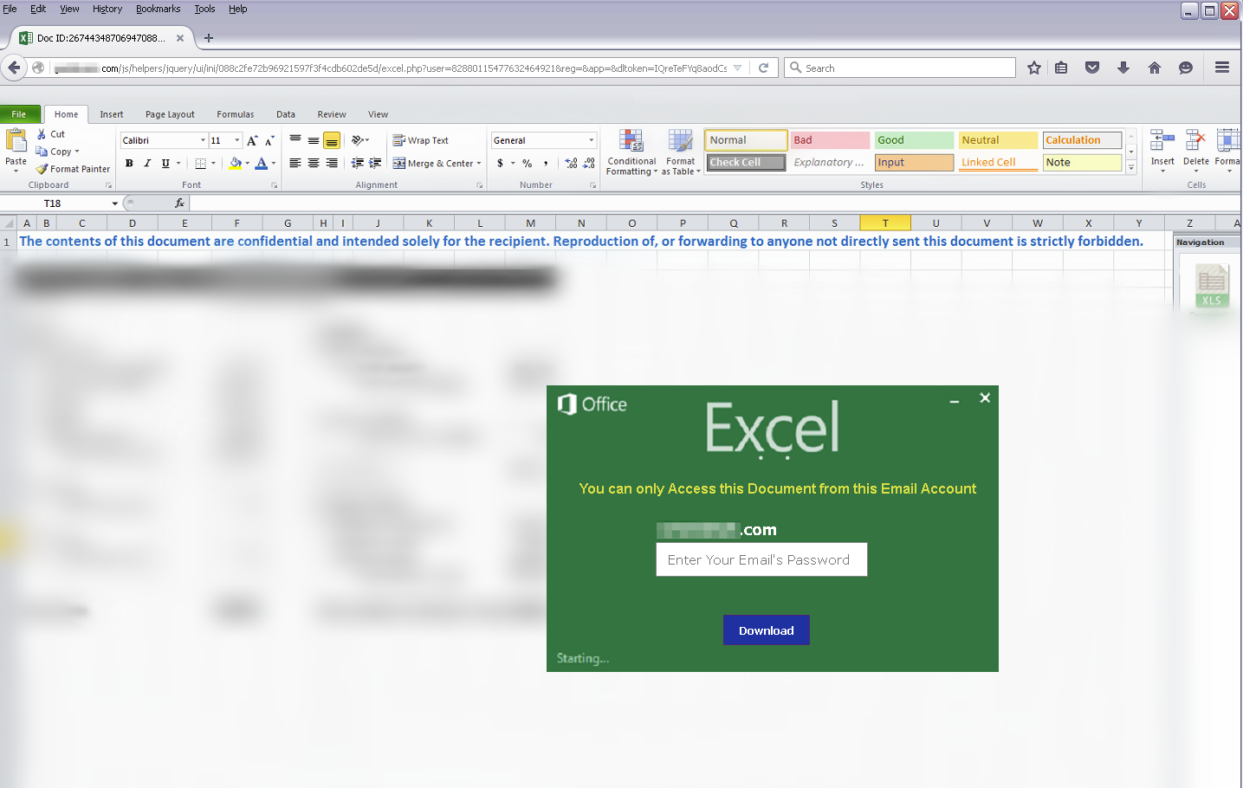
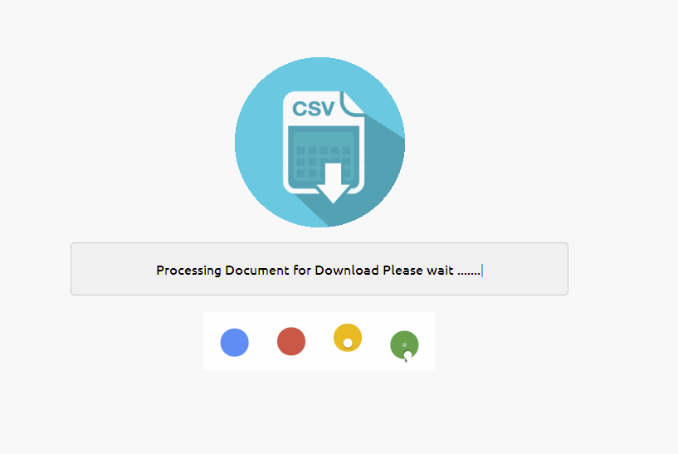
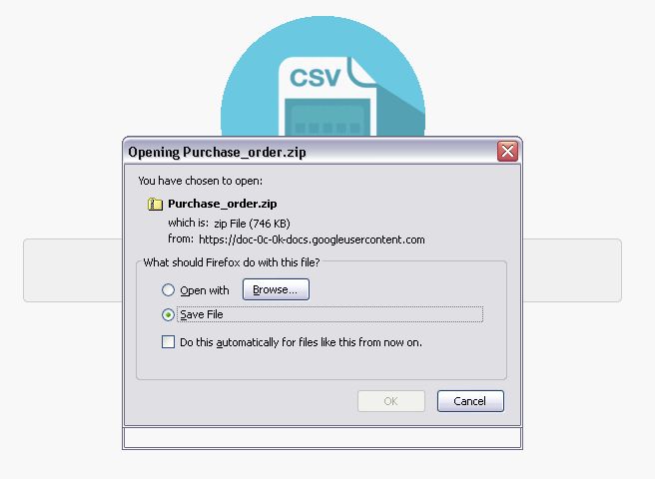

Credential phish leads to malware
Delivery strategy vary to evade security
  Link to XLS file. Leads to blurred Excel file asking for credentials.
  Downloads zip file that contains iSpy Keylogger malware
  Exe file disguised behind Microsoft Excel icon
Notes:
https://www.proofpoint.com/us/threat-insight/post/two-threats-for-price-of-one-credential-phishing-leads-to-ispy-keylogger
The XLS attachment in this case is a link, not a physical xls.
The link leads to a blurred Excel document rendered in the browser as well as a dialog box asking for the user's password in order to view the document.
The vast majority of credential phishing attacks would end at this stage when the user supplies the password associated with their email address. Threat actors can then begin looking for potential password reuse and other means to leverage the stolen credential. Often, a user would simply be directed to a fake CSV file or a common website like google.com.
In this case, after the user enters a password, the phish kit pretends to bundle up the requested documents with a fancy jquery animation
The user is then prompted to download the aforementioned zip file via https hosted by Google.
Figure 5: Prompt to download the "prepared files" (which are, in fact, a decoy that allows the installation of the malware specified by the threat actor)
Once unzipped, the file has a Microsoft Excel icon, but is, in fact, an executable compiled within the past week.
Figure 5: Prompt to download the "prepared files" (which are, in fact, a decoy that allows the installation of the malware specified by the threat actor)
Once unzipped, the file has a Microsoft Excel icon, but is, in fact, an executable compiled within the past week.
- Icon is
Users must be exceedingly vigilant as threat actors send out increasingly sophisticated lures and now have begun layering malware distribution capabilities onto standard phishing kits.
And in this case,

Slide 10
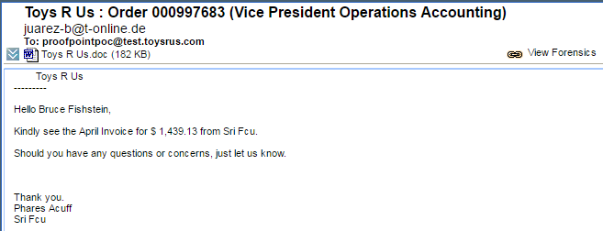
Targeted Attack – Locky Ransomware and Netwire Remote Admin
Weaponized Document specifically targeting Accounting VP Bruce F.
Message went to 1 employee
Results in Locky ransomware and remote access to machine

Slide 11
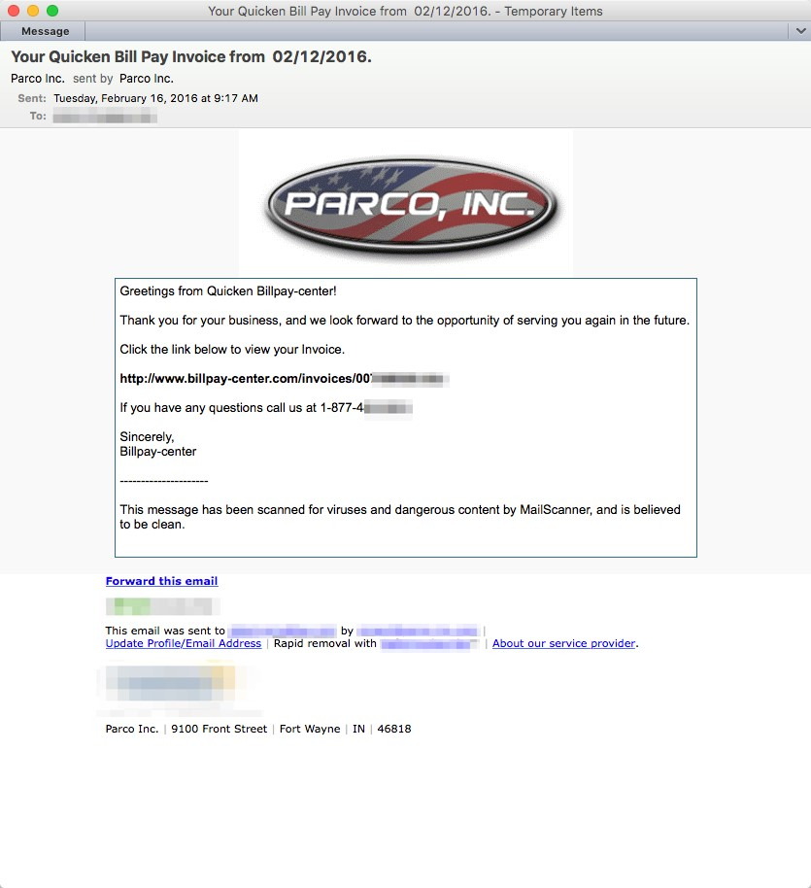
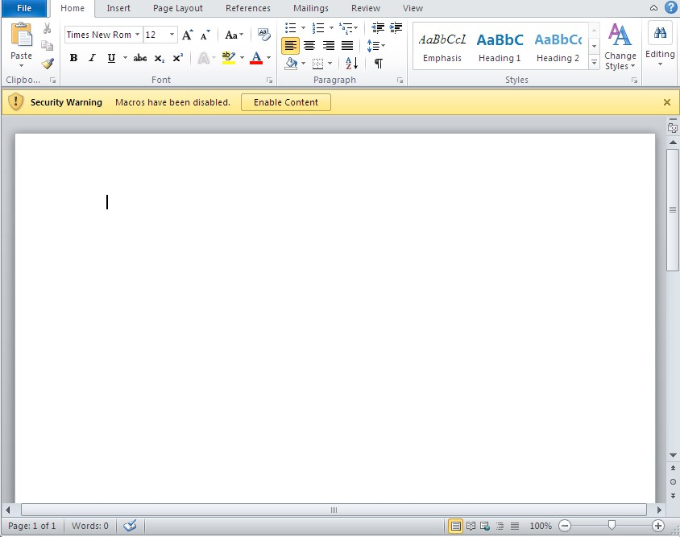
What’s old is now new again
Nymaim downloader Trojan – 2 year old strain
Distributed not by botnet nor drive-by-download from compromised or malicious websites. Uses legitimate email marketing service.
Notes:
Figure 1: Lure leveraging email marketing service
Figure 2: Malicious document downloaded from link shown in Figure 1

Slide 12






Not all threats are malware
Media attention on malware threats
Dridex
Ransomware
Malware-free threats growing rapidly
Credential phishing
Impostor Email
Notes:
Ransomware vaulted into the top ranks of malware most-preferred by cybercriminals. 24% of document attachment-based email attacks in Q1 2016 featured the new Locky ransomware. Dridex was the only malware payload used more frequently.
While As we look at 2016, we’re seeing a substantial share of attacks that do not use malware. And so you’re looking at the need to be effective against credential phishing, BEC/imposter, and think lures.
A lot of media attention on attachment based attacks
Seen massive campaigns that move very fast
Not the only thing to focus on though, rapidly growing threats are not malicious
Well known example is credential phishing
Being joined by what is known as Impostor Email
Both these threats are trying to steal from organizations, but they aren’t using malware to do it

Slide 13
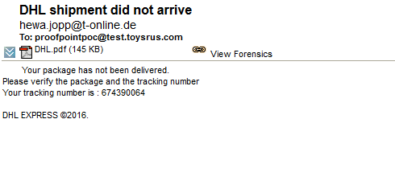
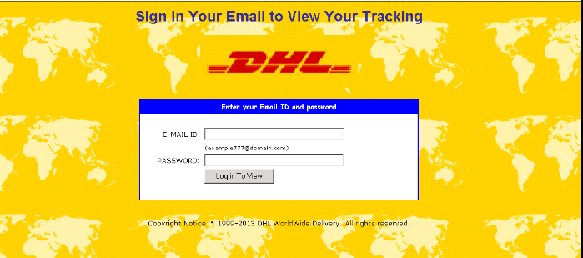
Targeted Credential Phish
Spear-phish contains URL leading to fake webmail login verification page. Results in credential theft
Scope:
  Malicious PDF automatically executes Malware payload
Impact:
  Message went to 1 employee
Notes:
Proofpoint monitored inbound mail flow and was configured in BCC mode behind Microsoft EOP and ATP, May 2016.

Slide 14


What is Impostor Email?
Business Email Compromise
Man-in-the-Email
CEO Fraud
Cost businesses
$3.1B
From 2013 – 2016 (May)
1300%
Increase since Jan 2015
Impostor email targets wire transfers and personal data
Source: FBI
Notes:
https://threatpost.com/fbi-email-scams-take-3-1-billion-toll-on-businesses/118696/?platform=hootsuite
Impostor is known by different names, you might have heard of the terms business email compromise, CEO fraud, or main in the email.
This threat is designed to trick the victim into thinking they received an email from the CEO, CFO or other leader asking for one of two thi
Wire money out of the organization (this is the normal request)
Send employee tax and social security information for a “review”
The FBI initially estimated that impostor email cost $1.2B, but has increased that to $2B given the rapid rise of 270% throughout 2015, and this seems to have increased even further in 2016.
These threats start with a great deal of research and social engineering to find the right person within an organization that deals with wire transfers, find out their chain of command, identify the best time to send the email – ideally when the “sender” is traveling in order to maximize the chance of being successful. But given the amount of work required, these threats are not seen in low numbers, many thousands of companies get impacted by these threats every month.

Slide 15

Impostor email is a global problem
UK – £32M ~1000 victims (July 2015 – Jan 2016) ²
France – €465M 15,000 victims
(since 2010) ³
US - $750M
17000+ victims (2013- 2016) ¹
Source: ¹ FBI, ² National Fraud Intelligence Bureau, ³. French National Police
Notes:
Impostor email isn’t a localized problem, it exists all over the globe, and affects businesses of all sizes so basically, whatever you do, and wherever you are you need to be vigilant. The downside can be massive, reaching millions of dollars in even a single successful campaign.

Slide 16
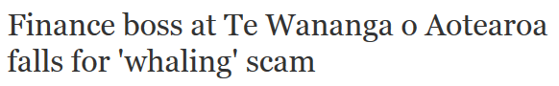
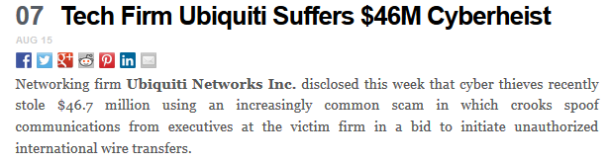
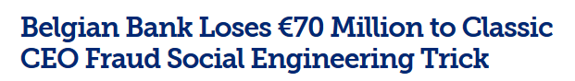
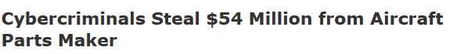
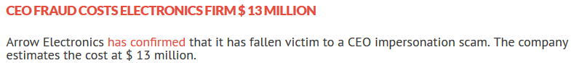
Big losses are possible very quickly
Notes:
As we see, from all over the world, firms that have become victims can lose very large sums of money very quickly! For a large organization this could be very painful, for a smaller organization it can mean the firm going out of business.
So why are firms falling prey to this type of attack? Why aren’t their email security solutions solving the problem and blocking the attacks.

Slide 17





Highly Researched & Targeted
No malware,
low volume
Research to understand employee structure
Often timed with executive travel schedule
Notes:
Impostor email threats are always highly researched before any communication is sent. Only employees with access to specific data or systems are targeted as they are ones who will actually be able to carry out the will of the attacker.
In terms of who is targeted, data suggests that those who work in HR, payroll or finance are more likely to targeted – this is of course due to the goal of these emails, to extract money or personal information from the organization.
Demonstrating the level of research before some threats, it has been seen that impostor emails can be timed with the travel schedule of the executive who is being mimicked. Getting this type of information can take time and a lot of effort, but if you look at the rapid potential time to success of an impostor email, and the large profit if the threat is successful, that’s a big goal that might be worth more work up front.

Slide 18
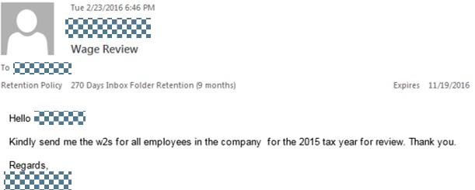
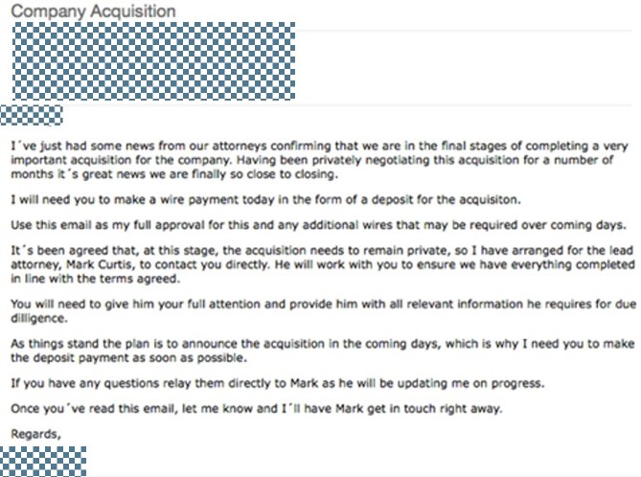
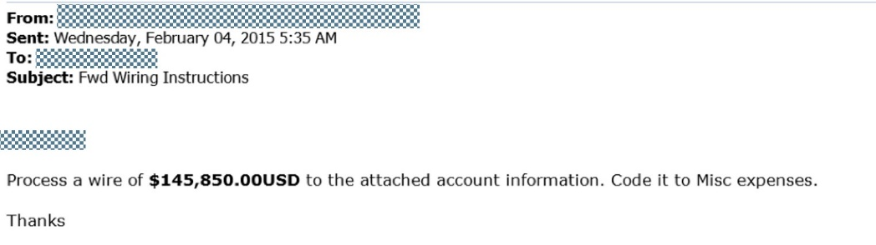
What does an Impostor Email look like?
Kindly send me
the w2s
Make a wire payment today in the form of a deposit for the acquisition
Process a wire of $143,850.00
Notes:
As you can see by looking at the examples emails here, impostor emails can come in all shapes and sizes, from a simple instruction to wire money or send tax information through to a complex process where the attacker is combining email with phone conversations, or introducing 3rd party people in order to make the scam seem more realistic. Another tactic is to limit the conversation only to email to try and prevent the victim from contacting the “sender” through a different method and finding out it’s fake.
From these emails you can see why it’s hard to figure out that they are fraudulent, but the devil is in the detail

Slide 19
Impostor Email Tactics
Data from March 2016

Slide 20
KEY REQUIREMENTS
AND BEST PRACTICES
Notes:
So let’s talk about the traditional approach to advanced threats.
In the old world, you might try a signature based engine, and some signature-less might still be using rules or signatures to some extent.
1 engine, 1 environment, for detection… SAME engine, SAME environment to learning anything they can (intel extraction). You might record hash/signature, then throw it away. It’s at such volume, there’s no real way to be throwing box resources to learn about something that is bad. How often does that sandbox get updated? And what do you get out of it.. a hash? Pretty easy for them to recover from updates to your defenses.
Missing persons cases can be among the most terrifying situations for families of those who are lost, and some of the most frustrating cases for police departments to resolve. Searching for a missing child, teenager, or elderly person can often feel like looking for a needle in a haystack. Considering how quickly and easily nearly anyone can access a myriad of transportation options, the search radius for a missing person can encompass the entire state or even the country.
Time is another complicating factor in missing persons cases. For each hour that a missing person is not found, the chances of ever finding them alive keep dropping. By the time a person’s absence is discovered, several hours may already have passed.
While anyone can become lost, wandering is particularly common in children with special needs, such as autism, and elderly people who suffer from dementia. Considering the fact that these individuals often present with a lack of awareness of danger, or impaired reasoning skills, they can quickly find themselves in dangerous or deadly situations.
When time is critical, don’t take chances with your loved one’s safety. Notify the police immediately
GPS geofence?

Slide 21

Best practices to prevent threats
URL threats
Attachment threats
Credential Phishing
Examples:
Links to compromised websites
URL links to attachments
Examples:
Office/PDF file types
JavaScript
Archived file
Examples:
DHL credentials
Google Docs
Registration sites
Look for:
URL sandboxing
Two sandboxing checks – scan and click time
Look for:
Breadth of file type support
Mobile sandboxes
Evasion countermeasures
Look for:
Data sources beyond email
Research and threat extraction focused on actors, relationships, infrastructure.
Static analysis
Notes:
There are four main best practices that cover people, process and technology.
Using technology, authentication and identity standards such as SPF, DKIM and DMARC can help block connections that don’t match the defined standards and registration information for IP addresses and domains.
Defined policy needs to be able to allow organizations to build policies that can identify impostor email, ideally policies will be pre-defined to ease the process. These policies should ideally allow for isolation of impostor emails from other spam and bulk mail to prevent end users beign fooled by emails in the email digest.
The people piece of the puzzle needs to be around training, especially for those in departments that manage financial transactions as those are likely to be targeted.
Finally process needs to be defined and written down to eliminate a single point of failure when it comes to the human element to falling for these impostor emails.
Everyone faces this in large large volume, or even highly targeted like this one, where we only saw 12 of them. Credentials are being compromised in all sorts of way, not just email, but extending to social and mobile.
Speaking Notes for describing credential phish functionality:
Start with a basic discussion of the sandboxes as having three basic detection elements:
Static, signature-based analysis of all the content received by the sandbox, including the entire web infection-chain.
Behavioral analysis – filesystem, mutexes, processes, registry changes, etc.
Network analysis – inspecting outbound, post-infection traffic for the download of additional payloads, c2, etc. (generic, and ET Pro rulesets)
*This also provides for an opportunity to discuss other things like ET (network), forensics + indicators (behavioral), identification of sandbox-aware or geographically restricted delivery mechanisms (static)
The focus here is our static analysis engine:
Typically, in the context of drive-by downloads, it was designed to detect iframers or other html/javascript elements that would be indicative of suspicious/malicious behavior.
We were able to leverage the same engine to write signatures to detect the content/output of certain toolkits commonly used to generate/copy credential phish pages.
It turns out, that many actors purchase the same kits to create these pages, and other more custom kits are re-used repeatedly by the same actors for long periods of time.
* I like to emphasize that there was an element of surprise here.. that this works WAY better than I expected, and as a threat-analyst, I consider it a key differentiator for our product. :)
Then, into the functionality and limitations:
if we’ve seen something before, there’s a very good chance it will be used again, and we’ll detect it again.
If it’s a kit that we haven’t seen before, or the kit’s output has been updated significantly, then we will miss it.
The real key here is that they report it to us as a cred phish FN, so we can write a signature to detect this in the future.
Especially if they received targeted cred phish, we need to be alerted to it so we can adjust our detection accordingly. If they can submit traffic captures, even better.
If they’re diligent about this, they’ll find that we can have good effectiveness against repeat targeted attacks, in addition to the commodity stuff.

Slide 22




Best practices to control Impostor Email
Email Authentication
Email Policy & Analysis
End User Training
Two factor policies for payments
SPF
DKIM
DMARC
Granular control
Complex policy support
Dynamic analysis
Understand threats
How to identify?
What to do
No single person authorization
Written approvals for large amounts
Notes:
There are four main best practices that cover people, process and technology.
Using technology, authentication and identity standards such as SPF, DKIM and DMARC can help block connections that don’t match the defined standards and registration information for IP addresses and domains.
Defined policy needs to be able to allow organizations to build policies that can identify impostor email, ideally policies will be pre-defined to ease the process. These policies should ideally allow for isolation of impostor emails from other spam and bulk mail to prevent end users beign fooled by emails in the email digest.
The people piece of the puzzle needs to be around training, especially for those in departments that manage financial transactions as those are likely to be targeted.
Finally process needs to be defined and written down to eliminate a single point of failure when it comes to the human element to falling for these impostor emails.

Slide 23
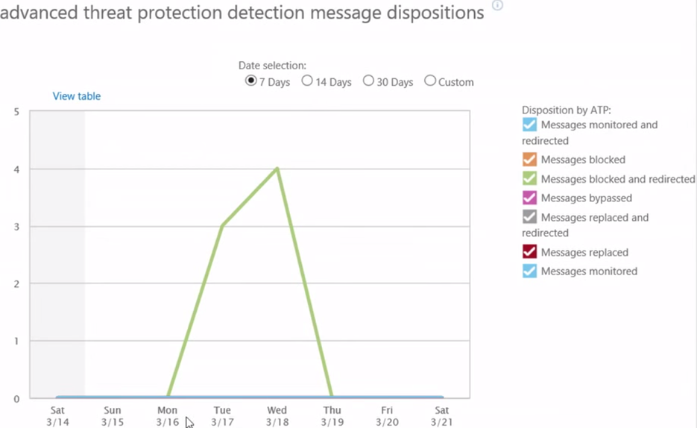
Visibility requirements into attacks targeting me
What details do you need to take action? i.e. why message is blocked, false positive cause, who is targeting the organization, who was targeted, from which device did they click.
What attack context details are available? such as malware category, phishing campaign type or screenshots that provide attack context.

Slide 24
Requirements for Rapid Response
Basic “where is my message”:
  How quickly are policy changes put into effect?
  How quickly are logs indexed for message searches?
  How quickly can you execute a message trace?
What measures are available to detect threats?
  Do you need integration of event data into SIEM?
  Does the solution continue to monitor the threat landscape and feed this intelligence back?
What measures are available to rapidly contain threat?
  What other security infrastructure should threat intelligence tie into to contain treats?
  Can you quickly extract emails with malicious content retrospectively out of the end users hands?
  What measures can it take to verify and contain a compromise?

Slide 25
HOW PROOFPOINT HELPS
Notes:
Dridex – banking
Locky – shot in the dark – large volumes.

Slide 26











Protecting Users
proofpoint nexus
90%+
1-5%
1-5%
5-10%
Hunt Externally
Protect the Attack Vectors
www
100101000101
Reduce Attack Surface
Hunt Internally
Respond Quickly

Slide 27





Proofpoint Threat Protetion for Office 365
BEFORE
DURING
AFTER
Proofpoint supports and provides protection for complex, staged Office 365 migrations while providing a unified experience for both IT and end users
Once the migration has completed, Proofpoint continues to protect Office 365 against advanced threats and targeted attacks
FIREWALL
Exchange 2003
Exchange 2007
Exchange 2013
Notes:
Our architecture helps with transition process to remove risk
We’ve helped many customers with this transition.

Slide 28


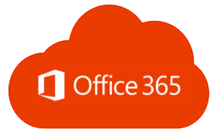



How Proofpoint Helps
Superior blocking of known and advanced threats
Immediate threat visibility and rapid response
Achieve eDiscovery & compliance readiness
Greater protection from compliance violations and information loss
Ensure uninterrupted access to live and historic email
Notes:
Office 365 is the #1 collaboration platform. We support our customers who move in this direction, either fully onto Office 365 or in a hybrid mode. We help them achieve the level of security and compliance demanded by their organizations.
I’ll touch on the key areas at a high level, and then pause to see if there are particular areas of interest you would like to dive into.
Business email compromise, advanced malware, targeted attacks, bulk mail. You don’t need me to tell you that attacks continually evolve. We invest 25% of our revenue directly back into R&D. Our customers tell us that blocking attacks that otherwise would be successful is one of the greatest values that Proofpoint delivers. Efficacy cannot be measured by a feature comparison chart. I strongly encourage you test the efficacy for yourself, and we’re happy to connect you with our customers who came to us from Office 365 to get their experience.
Effective security doesn’t stop at blocking. We hear from CIOs and CSOs that when it comes to Office 365, they want immediate visibility. They want visibility into the threats targeting their user, from who is attacking them, to knowing from which device their user clicked. to respond to incidences are critical to their success. They also want rapid response capabilities. Email security needs to integrate with their broader security ecosystem to detect IoCs and contain incidences in an orchestrated way.
Proofpoint provides advanced capabilities to protect from compliance violations and information loss, keeping your sensitive data, whether in motion or at rest safe with encryption and information protection capabilities with granular policies and remediation workflows.
If you are looking for a true archive, that is, a solution that is defensible for regulatory compliance (SEC, FINRA) and in court, and require discover and legal holds, we help solve this challenges. We meet the most stringent compliance and eDiscovery requirements, and seamlessly archive corporate data as it flows through Exchange Online, Yammer, Skype for Business, OneDrive for Business, Sharepoint, and other content sources including Facebook, LinkedIn, and more.
Lastly, downtime of Office 365 is a big concern. Global outages and local outages have resulted in downtime for hours, even half a day. With Proofpoint, we can keep your end users connected to email with an email continuity service to keep your users productive, and not conduct email via their personal accounts, in the event of an Office 365 email downtime.

Slide 29














Comprehensive URL Protection
Email arrives
Reputation
Email
Gateway
Check reputation. Quarantine known threats.
Redirector
End-to-End Insight
Blacklist
Sandbox
URL-Specific Module
Rewrite URLs. Send to user.
Real Time Intelligence
Malware
Behavior
Code
302 Redirect
URL clicked
Threat Detection Analytics
{ Clean }
{ Threat }
Protect Anywhere
Notes:
Email arrives containing the attachment, which is then sent to the Proofpoint Protection Server (PPS). PPS can be deployed as a on-premise appliance, virtual appliance or in the cloud.
PPS contains optional modules, in this case it would be the Attachment Defense Module.
The Attachment Defense Module would send a copy of the file to the Proofpoint Cloud to check its reputation, meaning whether we have seen the file hash before. A verdict would be returned as “threat”, “clean” or “unknown”.
If the response is “unknown”, the file is preemptively sent to the sandbox which uses dynamic and static analysis techniques to identify malware, abnormal behavior and suspicious code.
If the response is “clean” then the file can be downloaded, as expected. If the response is “threat” then the file is blocked from download and quarantined.
End-to-end insight gives administrators a view across the entire attack chain, so you can still see after the asset has been checked and clicked. So if an asset has been delivered an clicked (which can happen for a number of reasons: audit mode or delivered before sandbox successfully completed analysis), TAP still tracks that so that administrators can see the IPs or users to further investigate. This forensic information is visible on the TAP dashboard or can be fed into Threat Response.
Real time intelligence – Discuss graph database and Emerging Threats
Protect anywhere – On and off network, on any device (PC, mobile)

Slide 30




Comprehensive Attachment Protection
Email
Gateway
Reputation
Email arrives
Attachment–Specific Module
Hold files until receive verdict.
Quarantines threats.
End-to-End Insight
Hash
Sandbox
Real Time Intelligence
Malware
Behavior
Code
Threat Detection Analytics
{ Clean }
{ Threat }
Protect Anywhere
Extraordinary Measures
Notes:
Email arrives containing the attachment, which is then sent to the Proofpoint Protection Server (PPS). PPS can be deployed as a on-premise appliance, virtual appliance or in the cloud.
PPS contains optional modules, in this case it would be the Attachment Defense Module.
The Attachment Defense Module would send a copy of the file to the Proofpoint Cloud to check its reputation, meaning whether we have seen the file hash before. A verdict would be returned as “threat”, “clean” or “unknown”.
If the response is “unknown”, the file is preemptively sent to the sandbox which uses dynamic and static analysis techniques to identify malware, abnormal behavior and suspicious code.
If the response is “clean” then the file can be downloaded, as expected. If the response is “threat” then the file is blocked from download and quarantined.
End-to-end insight gives administrators a view across the entire attack chain, so you can still see after the asset has been checked and clicked. So if an asset has been delivered an clicked (which can happen for a number of reasons: audit mode or delivered before sandbox successfully completed analysis), TAP still tracks that so that administrators can see the IPs or users to further investigate. This forensic information is visible on the TAP dashboard or can be fed into Threat Response.
Real time intelligence – Discuss graph database and Emerging Threats
Protect anywhere – On and off network, on any device (PC, mobile)

Slide 31
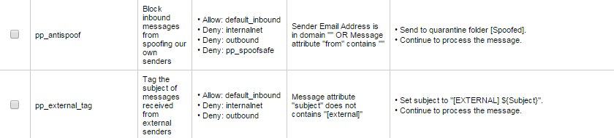
Pre-defined policies
Move email identified as impostor to a separate quarantine
Flag emails as being external to aid in end user training
Notes:
8.3. Rolled out policies in our email firewall. To reiterate, this could have been done 2-3 years ago, you could have built these rules. When we saw this threat growing, to make it easy as possible so you don’t have to figure out how to build these rules. Built predefined rules. You can check the box, enter in your domain, pick what you want to do for that action.
Here, we have 2 examples of what that action that might be:
If you see an email come from one of my domain, but from an external email, then, what do you want it to do? >> put it into quarantine, remove this imposter email.
2nd piece: not around stopping email from coming through (depends on the stance you want to take). Internal domain, external IP address, can flag the email as external (ties in with end user training), but if subject line has external in it with green text, then it should be suspicious.
That quarantine, in terms of separating out email, we classify different emails into different quarantines, one of those quaratines is imposter.
So when
Quarantine, in terms of separating out email, we classify
Proofpoint Email Security, combining Email Protection and Targeted Attack Protection combines both sides of protection including both accurate malware detection for both URLs and attachments and the ability to identify and block malware-free incursions such as credential phishing and impostor email.
Canned rules help administrators quickly build policy to identify and quarantine impostor emails, or tag those suspect emails to allow end users to more easily identify the threats.
Impostor email detection is an area of focused development by Proofpoint to continue to protect our customers from emerging threats.

Slide 32
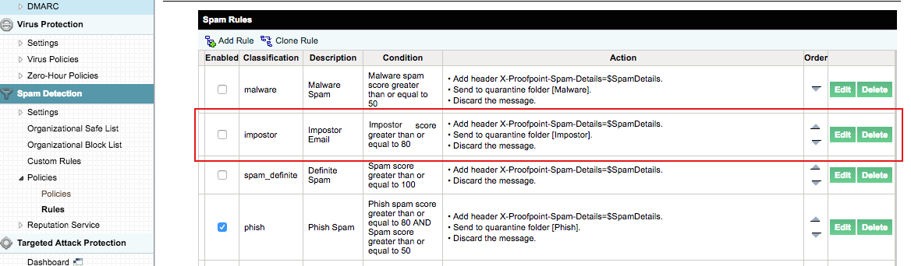
Impostor Email Classifier and Rules

Slide 33
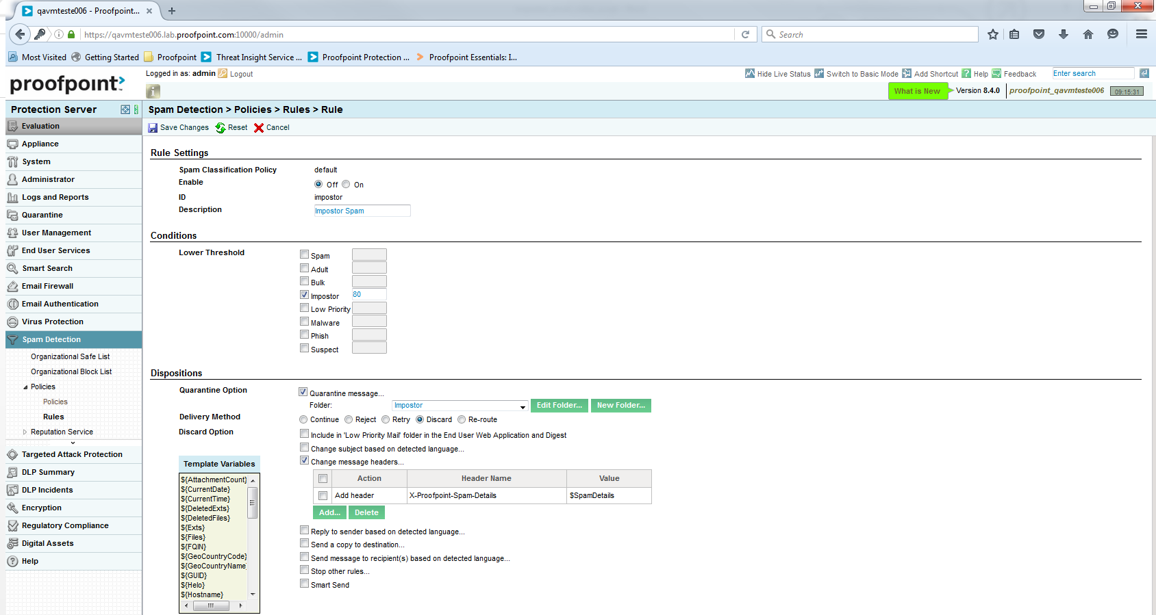
Notes:
Rule Settings
Rules can be edited using the attributes and template variables shown.

Slide 34

Impostor Classifier
Sender / Recipient Reputation
This composite approach provides multi-layered analysis of email to detect impostor email
Impostor Score
Domain Reputation
Algorithmic Evaluations
Returns impostor score indicating probability of fraud
Notes:
To augment the pre-defined policies, Proofpoint is focusing on developing a new classifier (in addition to spam, adult, bulk, phish and malware) in order to provide greater visibility and control into impostor email.
In order to do this, email is analyzed across many different facets including the sender/recipient details, domain reputation and also algorithmic analysis of content; a composite score, or Impostor score is given to the mail. Administrators can then define policies based on the impostor score.

Slide 35
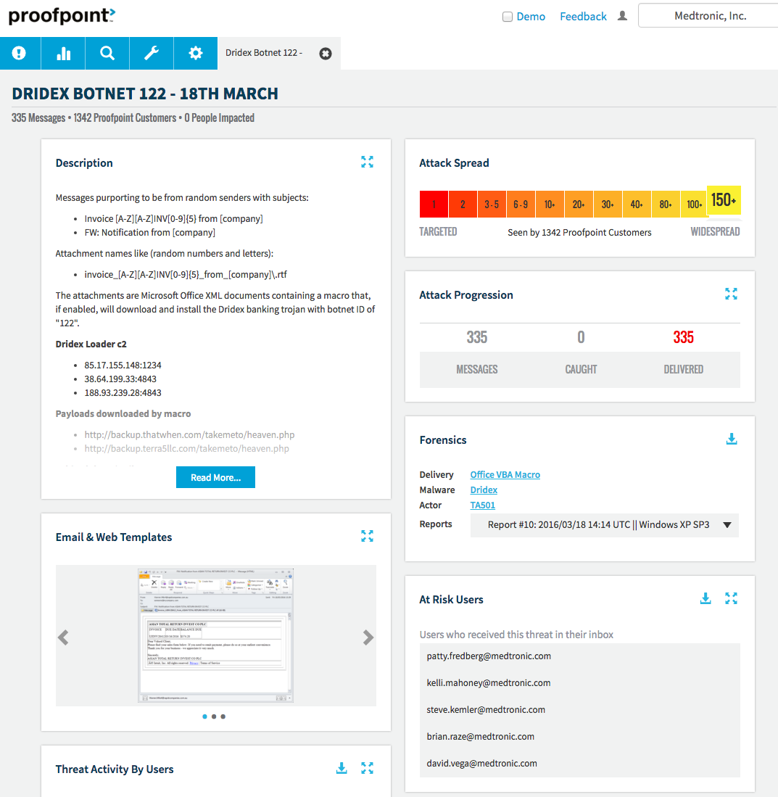
True Insight
Detailed campaign data, including threat actor and level of targeting
Thorough, actionable forensics
Clear identification of users and devices potentially affected

Slide 36


















Response and Orchestration
Detect
Respond
Auto-Purge removes threats
End-to-end insights with campaign analysis: Who clicked, when, what happened
Quarantine
URL Enforcement Points
Leverage expertise: Threat Operations Center
URL, network, and user access enforcement points
Network Enforcement Points
User Access Enforcement Points
Active Directory
Real-time streams to SIEM
Automated forensic collection and verdict of infection
Notes:
It’s not enough to block threats. Particularly in our conversations with CIOs and CSOs when it comes to Office 365, they are looking for greater visibility into the threats in their environment, as well as how they will respond to threats.
You can’t respond to what you can’t see, and our end-to-end insights…
This provides the context to help have the board level coversations.
Security expertise is a shortage. The researchers at the threat operations center are assessing the threat landscape….
Integration into SIEM.
Respond to indicators of compromise
Gain visibility and insights
Leverage Threat Operations Center expertise
Auto-purge
SIEM, URL and Network enforcement integration
Automated forensics collection – cuts time to response/remediation

Slide 37
Tales from the Trenches:
What Was the Greatest Benefit to Better Protecting O365?
“Protection from standard bulk crap campaigns, giving us our time back to focus on the really evil stuff.”
- CISO, Global 500 Manufacturer
“Our phishing problems have pretty much gone away. Despite all the end user training we provided over the years to not click and enter your credentials, the old solution allowed too much through and we had users fall victim. Since implementation, I can’t recall the last time it happened.”
- Admin, Private University

Slide 38
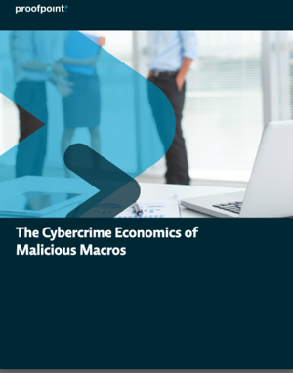
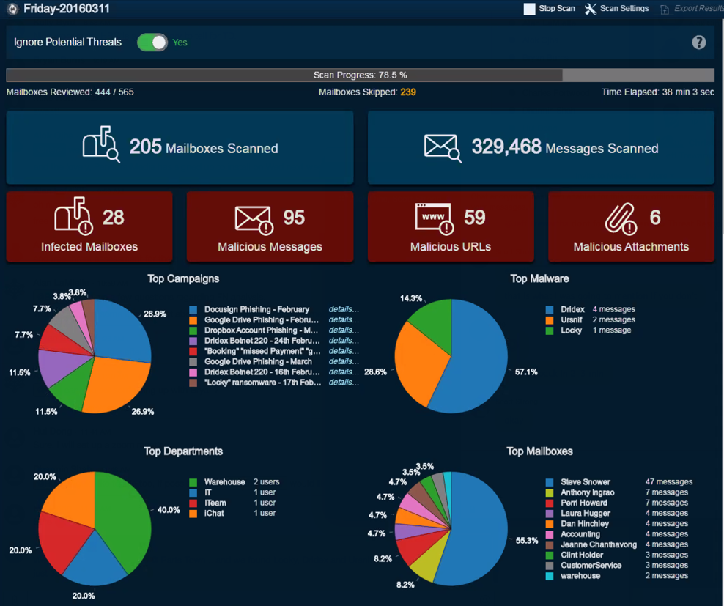
Next Steps
Microsoft Office 365 Discovery Workshop
  A 90-minute working session designed to help you build and execute your Office 365 migration plan
  Topics include:
  Considerations before, during & after the move
  Mail architecture
  Office 365 package options
  Email security, availability, and compliance requirements (encryption/DLP/archiving)
Threat Assessment for Office 365 Email
Microsoft Office 365 Migration
A Recommendation from Proofpoint
Visit www.proofpoint.com/ask-365-expert or www.proofpoint.com/office365

